Slide 1
Programmable Interval Timer 8254
The Intel 8254 is a counter/timer device designed to solve the common timing control problems in microcomputer system design.
It provides three independent 16-bit counters, each capable of handling clock inputs up to 10 MHz.
It has 6 modes and all are software programmable.
The 8254 is a superset of the 8253.
HEMANT SINGH POKHARIYA, A.P. CSE DEPT.GRAPHIC ERA DEEMED TO BE UNIVERSITY DEHRADUN

Slide 2
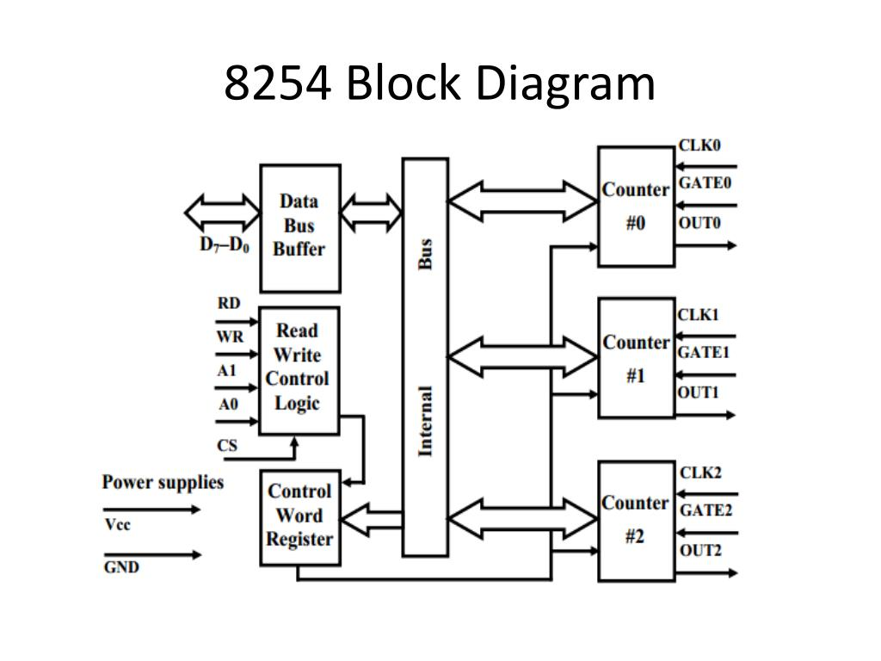

Slide 3
Operating modes of 8254
Mode 0 ─ Interrupt on Terminal Count
Mode 1 – Programmable One Shot
Mode 2 – Rate Generator
Mode 3 – Square Wave Generator
Mode 4 − Software Triggered Mode
Mode 5 – Hardware Triggered Mode

Slide 4
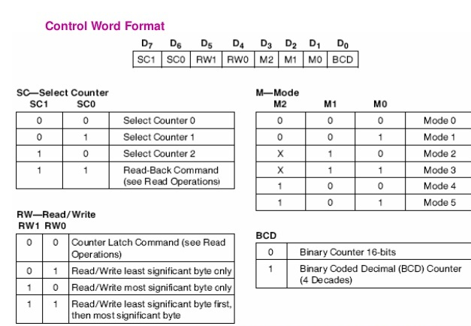
Control word of 8254

Slide 5
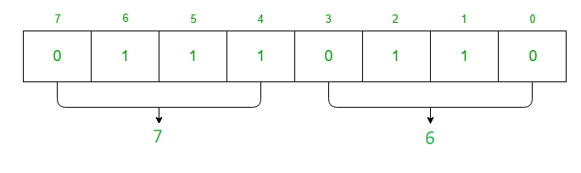
Write an assembly language program in 8085 microprocessor which generates 1 KHz square waveform by using counter 1 as a binary counter if clock frequency of 8254 is 2 MHz.
count = 2 MHz / 1 KHz = 2000 = (07D0)H
CR
Suppose port address are C0=80H,C1=81H,C2=82H,CR =83H
MVI A 76
OUT 83
MVI A D0
OUT 81
MVI A 07
OUT 81
HLT

Slide 6
Thanks For Watching

